Slide 1
Discrete Structures
CS-1005
GCR: e2d2awt
Lecture -4
by
Dr. Fehmida Usmani

Slide 2
Functions
Bijection
Consider a function that is both one-to-one and onto:
Such a function is a one-to-one
correspondence, or a bijection.
a
b
c
d
1
2
3
4

Slide 3
Functions
Just as we are able to add (+), subtract (-), multiply (*), and divide (÷) two or more numbers, we are able to + , - , * , and ÷ two or more functions
Let f and g be functions from A to R. Then f + g, f – g, f * g and f/g are also functions from A to R defined for all x ∈ A by:
(f + g)(x) = f(x) + g(x)
(f - g)(x) = f(x) - g(x)
(f *g)(x) = f (x)*g(x)
(f/g)(x) = f(x)/g(x) given that g(x)≠0

Slide 4
Functions
Let f₁ and f₂ be functions from R to R such that:
f₁(x) = 2x
f₂(x) = x²
Find f₁ + f₂ and f₁*f_{2.}
f₁+f₂ = (f₁+f₂)(x) = f₁(x)+f₂(x) = 2x+x²
f₁*f₂ = (f₁*f₂)(x) = f₁(x)*f₂(x) = 2x*x² = 2x³

Slide 5
Functions
Let f and g be functions from R to R such that:
f (x) = 3x+2 g (x) = -2x + 1
What is the function f *g?
f*g = (f*g) (x) = f (x)*g(x) = (3x+2)*(-2x+1) = -6x²- x +2
Let x = -1, what is f(-1)*g(-1) and (f*g)(-1)?
f (-1) = 3(-1) + 2 = -1
g(-1) = -2(-1) + 1= 3
f(-1)*g(-1) = -1×3 = -3
(f *g) (-1) = -6(-1)2 – (-1) + 2 = -6+1+2 = -3

Slide 6
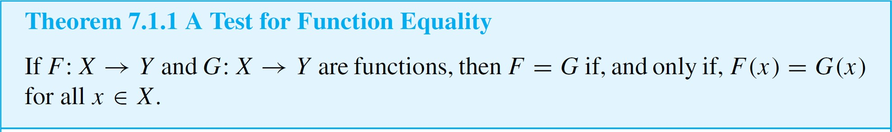
Equality of Functions
Earlier we have given a test for determining whether two functions with the same domain and co-domain are equal, saying that the test results from the definition of a function as a binary relation.
We formalize this justification in Theorem 7.1.1.

Slide 7
Equality of Functions
Two functions are equal if they have the same domain, the same codomain, and for every element x in the domain, the corresponding elements in the codomain are the same (i.e., f(x)=g(x)f(x) = g(x)f(x)=g(x) for all x)

Slide 8
Equality of Functions
a. Let J₃ = {0, 1, 2}, and define functions f and g from J₃ to
J₃ as follows: For all x in J₃,
Does f = g?
b. Let F: R → R and G: R → R be functions. Define new functions F + G: R → R and G + F: R → R as follows: For all x ∈ R,
Does F + G = G + F?

Slide 9
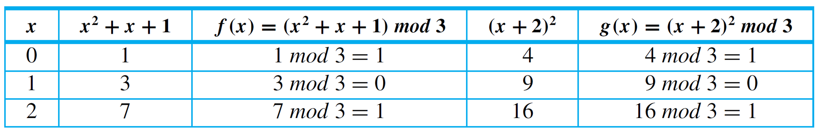




Equality of Functions
a. Yes, the table of values shows that f(x) = g(x) for all x in
J₃.
b. Again the answer is yes. For all real numbers x,
Hence F + G = G + F.

Slide 10
Identity Functions
A function such that the image and the pre-image are ALWAYS equal
f(x) = 1*x
f(x) = x + 0
The domain and the co-domain must be the same set.

Slide 11
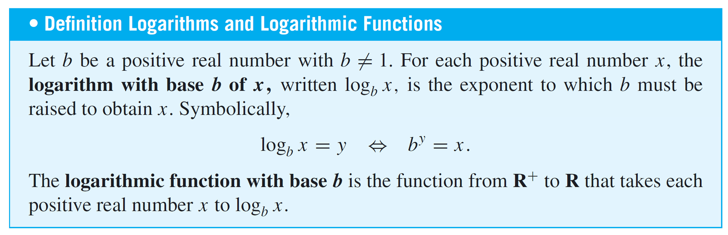
Functions

Slide 12
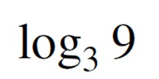
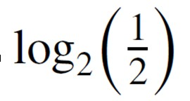



Functions
Find the following:
a. b.
d.
Solution:
a.
b.
c.

Slide 13

Functions
d.
because the exponent to which 2 must be raised to obtain 2^{m} is m.

Slide 14

Encoding and Decoding Functions
Digital messages consist of finite sequences of 0’s and 1’s. When they are communicated across a transmission channel, they are frequently coded in special ways to reduce the possibility that they will be garbled by interfering noise in the transmission lines.
For example, suppose a message consists of a sequence of 0’s and 1’s. A simple way to encode the message is to write each bit three times. Thus the message
would be encoded as

Slide 15
Encoding and Decoding Functions
The receiver of the message decodes it by replacing each section of three identical bits by the one bit to which all three are equal.
Let A be the set of all strings of 0’s and 1’s, and let T be the set of all strings of 0’s and 1’s that consist of consecutive triples of identical bits.
The encoding and decoding processes described above are actually functions from A to T and from T to A.

Slide 16
Encoding and Decoding Functions
The encoding function E is the function from A to T defined as follows: For each string s ∈ A,
E(s) = the string obtained from s by replacing
each
bit of s by the same bit written three
times.
The decoding function D is defined as follows: For each string t ∈ T,
D(t) = the string obtained from t by replacing consecutive triple of three identical bits of t by
each

Slide 17
Encoding and Decoding Functions
The advantage of this particular coding scheme is that it makes it possible to do a certain amount of error correction when interference in the transmission channels has introduced errors into the stream of bits.
If the receiver of the coded message observes that one of the sections of three consecutive bits that should be identical does not consist of identical bits, then one bit differs from the other two.
In this case, if errors are rare, it is likely that the single bit that is different is the one in error, and this bit is changed to agree with the other two before decoding.

Slide 18
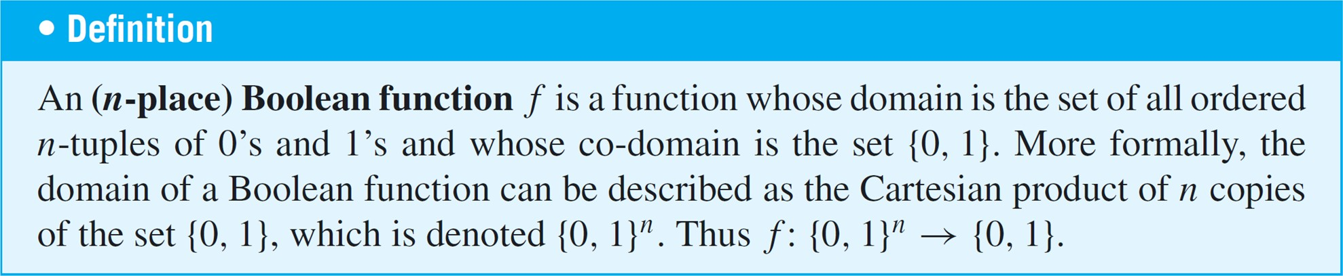
Boolean Functions

Slide 19
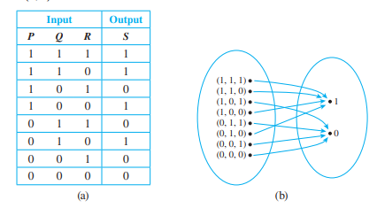
Boolean Functions

Slide 20
Boolean Functions
Consider the three-place Boolean function defined from the set of all 3-tuples of 0’s and 1’s to {0, 1} as follows: For each triple (x₁, x₂, x₃) of 0’s and 1’s,
Describe f using an input/output table.
Solution:

Slide 21
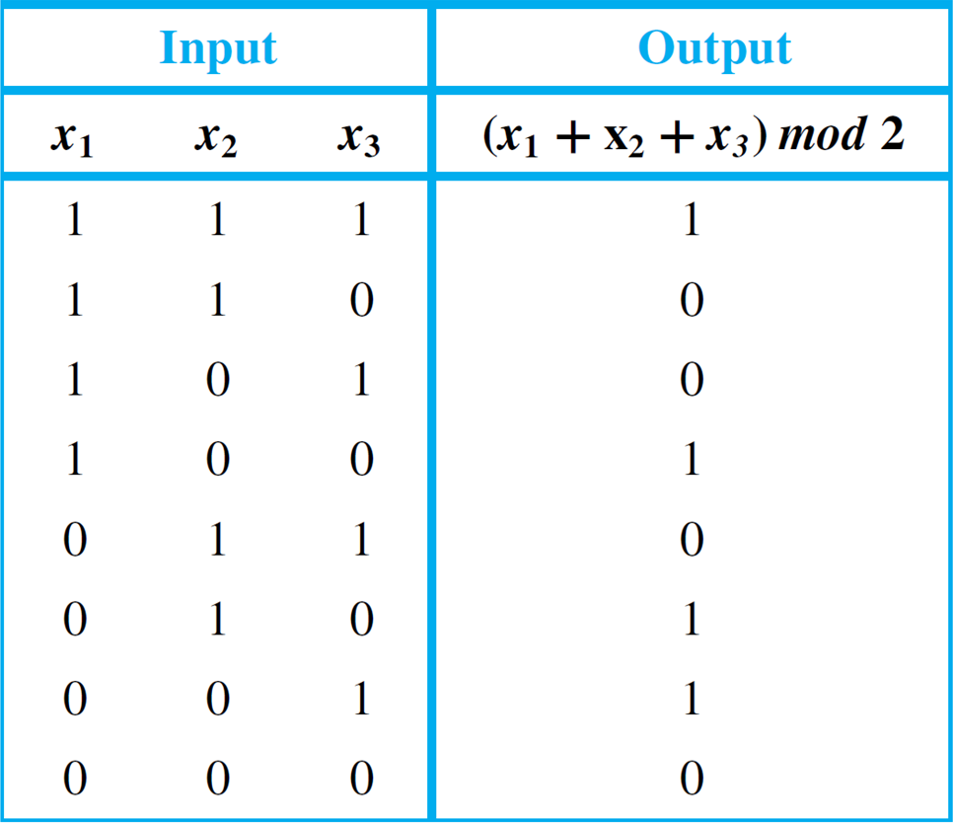
Boolean Functions
The rest of the values of f can be calculated similarly to obtain the following table.

Slide 22
Checking whether the function is well defined
It can sometimes happen that what appears to be a function defined by a rule is not really a function at all. To give an example, suppose we wrote, “Define a function
f : R → R by specifying that for all real numbers x,
There are two distinct reasons why this description does not define a function. For almost all values of x, either (1) there is no y that satisfies the given equation or (2) there are two different values of y that satisfy the equation.

Slide 23
Checking whether the function is well defined
For instance, when x = 2, there is no real number y such that 2² + y² = 1, and when x = 0, both y = –1 and y = 1 satisfy the equation 0² + y² = 1.
In general, we say that a “function” is not well defined if it fails to satisfy at least one of the requirements for being a function.

Slide 24
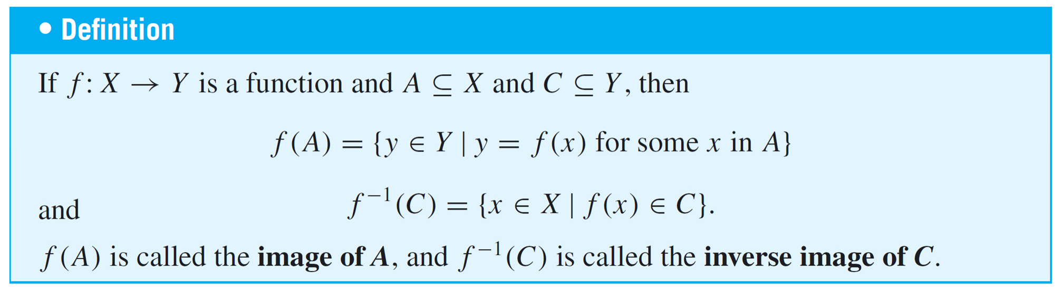
Functions on Sets
Given a function from a set X to a set Y, you can consider the set of images in Y of all the elements in a subset of X and the set of inverse images in X of all the elements in a
subset of Y.

Slide 25
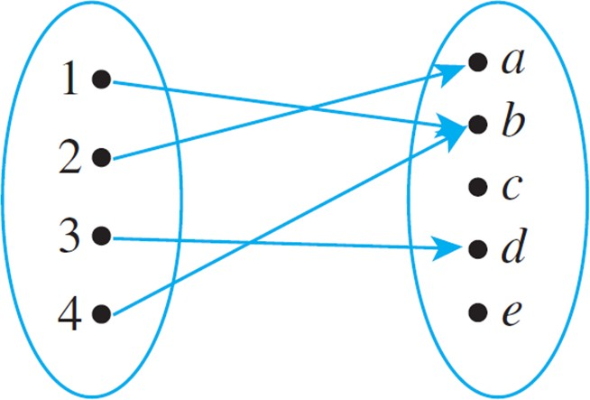
Functions on Sets
Let X = {1, 2, 3, 4} and Y = {a, b, c, d, e}, and define
F : X → Y by the following arrow diagram:
Let A = {1, 4}, C = {a, b}, and D = {c, e}. Find F(A), F(X), F⁻¹(C), and F⁻¹(D).

Slide 26




Functions on Sets

Slide 27
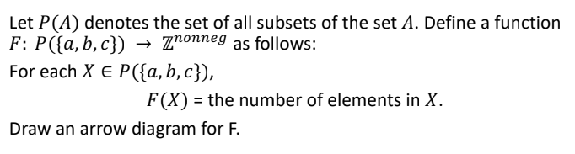
Functions on Power Sets

Slide 28
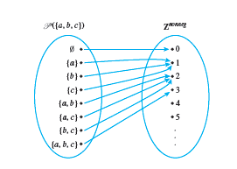
Functions on Power Sets

Slide 29
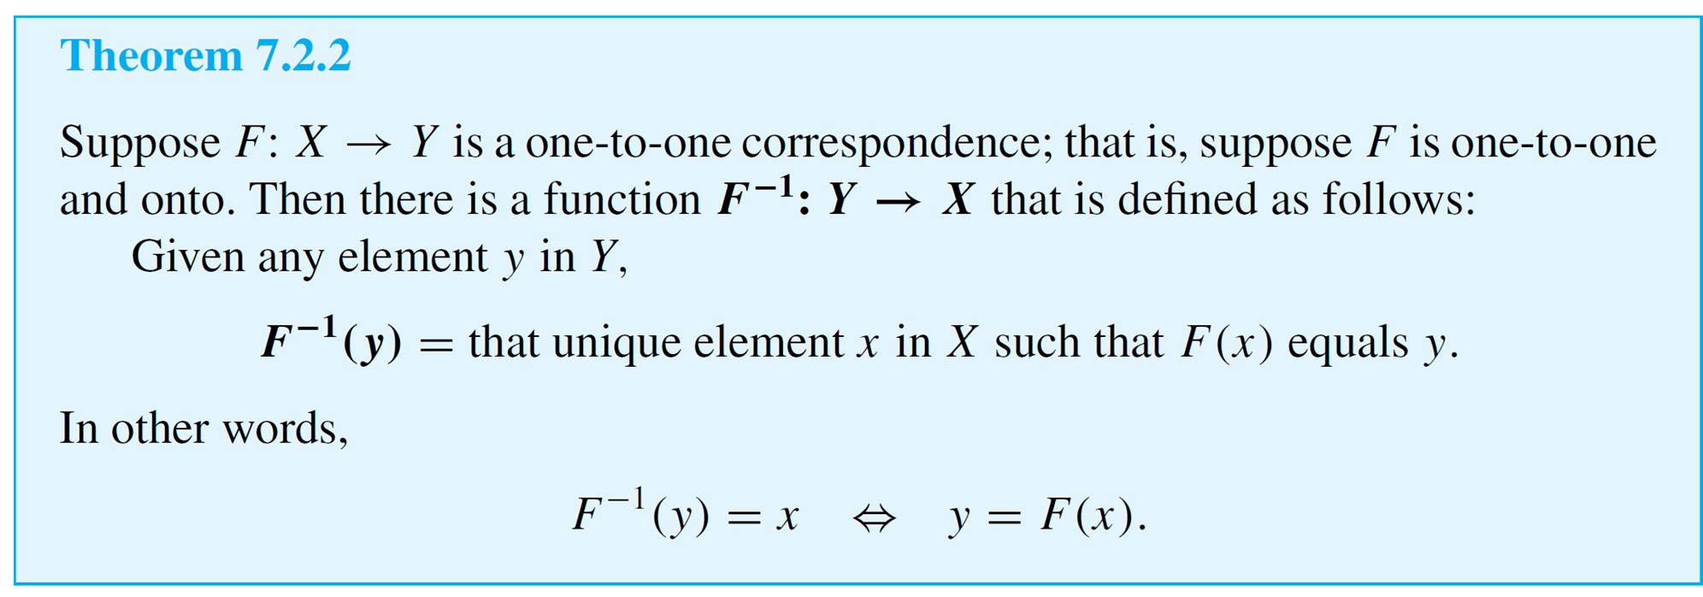
Inverse Functions
If F is a one-to-one correspondence from a set X to a set Y, then there is a function from Y to X that “undoes” the action of F; that is, it sends each element of Y back to the element of X that it came from. This function is called the inverse function for F.

Slide 30
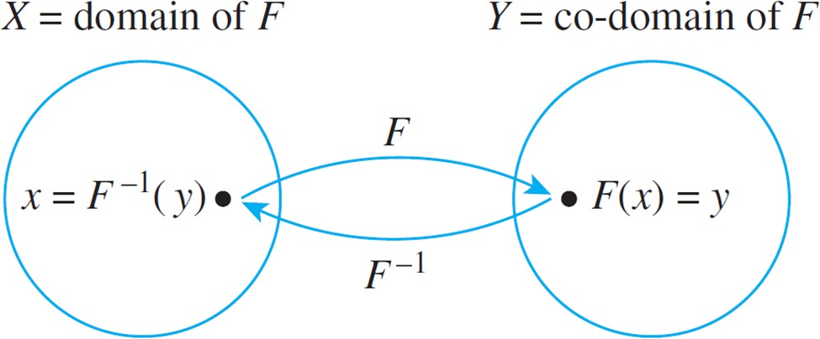
Inverse Function
The diagram that follows illustrates the fact that an inverse function sends each element back to where it came from.

Slide 31
Inverse Function
Can we define the inverse of the following functions?
An inverse function can ONLY be done defined on a bijection
a
b
c
1
2
3
4
a
b
c
d
1
2
3
What is f⁻¹(2)?
Not onto!
What is f⁻¹(2)?
Not 1-to-1!

Slide 32
Inverse Function
A one-to-one correspondence is called invertible because we can define an inverse of this function.
A function is not invertible if it is not a one-to-one correspondence, because the inverse of such a function does not exist.

Slide 33
Inverse Functions
Let f be the function from {a, b, c} to {1, 2, 3} such that
f (a) = 2, f (b) = 3, and f (c) = 1.
Is f invertible, and if it is, what is its inverse?
So, here f(a)=2⟹ f⁻¹(2)=a
f(b)=3 ⟹f⁻¹(3) = b
f(c)=1 ⟹f⁻¹(1)=c

Slide 34
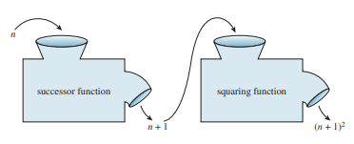
Compositions of Functions
Combining functions in this way is called composing them; the resulting function is called the composition of the two functions. Note that the composition can be formed only if the output of the first function is acceptable input to the second function. That is, the range of the first function must be contained in the domain of the second function.

Slide 35

Compositions of Functions
Let g be a function from the set A to the set B and let f be a function from the set B to the set C. the compositions of the functions f and g, denoted by f $°$g, is defined by
$$\text{(}\text{f} °\text{g}\text{)(}a\text{)}=\text{f} \text{(}\text{g}\text{(}\text{a}\text{))}$$
The composition of functions is a mathematical operation that involves applying one function to the result of another function. Given two functions f and g, the composition of f and g is a new function that is formed by applying g first and then applying f to the result of g.

Slide 36
Compositions of Functions
Let g be a function from the set A to the set B and let f be a function from the set B to the set C. the compositions of the functions f and g, denoted by f $°$g, is defined by
$$\text{(}\text{f} °\text{g}\text{)(}a\text{)}=\text{f} \text{(}\text{g}\text{(}\text{a}\text{))}$$
The composition of functions is a mathematical operation that involves applying one function to the result of another function. Given two functions f and g, the composition of f and g is a new function that is formed by applying g first and then applying f to the result of g.

Slide 37
Compositions of Functions
Set X: {1,2,3}
Set Y: {4,5,6}
Set Z: {7,8,9}
Functions
Function f:X→Y
f(1)=4,f(2)=5,f(3)=6
2. Function g:Y→Z
g(4)=8,g(5)=7,g(6)=9

Slide 38
Compositions of Functions
The composition of g and f is denoted by g∘f , which is a function from X to Z. The composition is defined as:
(g∘f)(x)=g(f(x))
Let’s compute g∘fg \circ fg∘f for each element in XXX:
For x=1
f(1)=4 and g(4)=8
(g∘f)(1)=g(f(1))=g(4)=8
For x=2
f(2)=5 and g(5)=7
So, (g∘f)(2)=g(f(2))=g(5)=7
For x=3
f(3)=6 and g(6)=9
, (g∘f)(3)=g(f(3))=g(6)=9

Slide 39
Compositions of Functions
The composition function g∘f: X→Z:
(g∘f)(1)=8,(g∘f)(2)=7,(g∘f)(3)=9
So, the function g∘f maps:
1↦8,2↦7,3↦9

